Slide 1

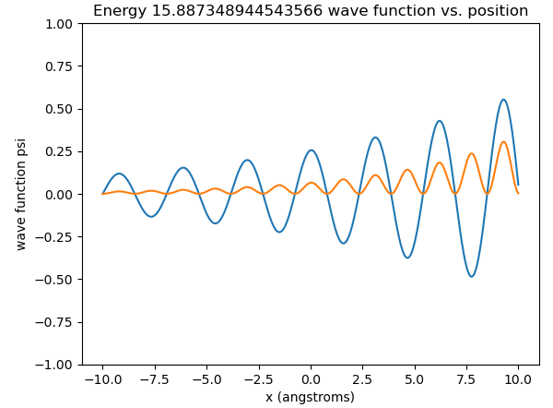
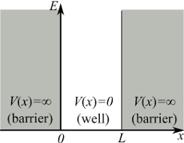
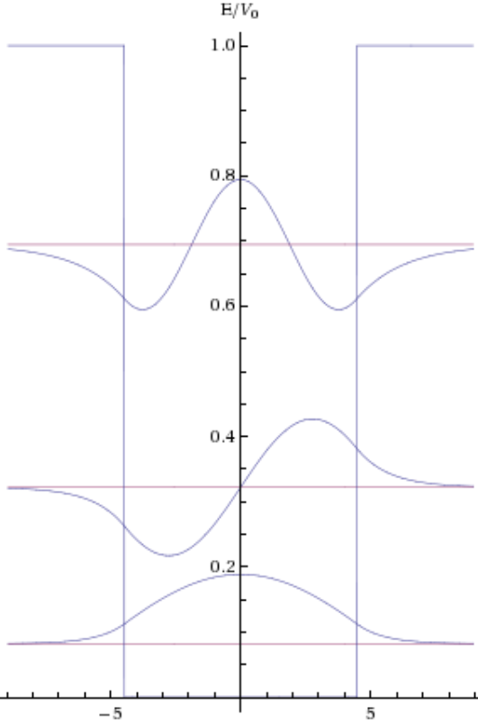
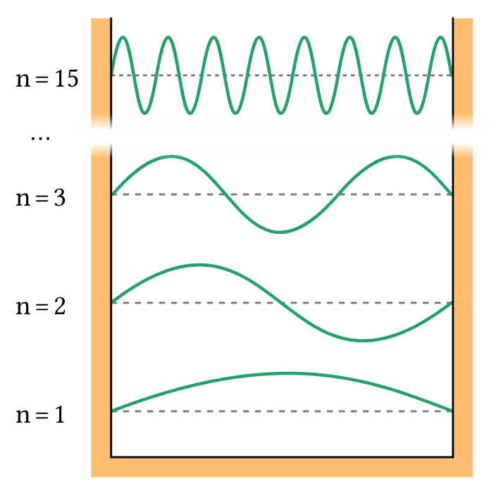
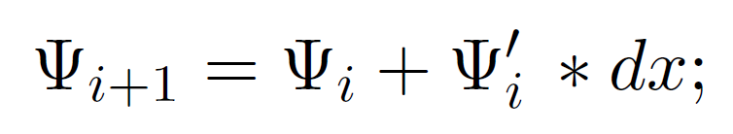
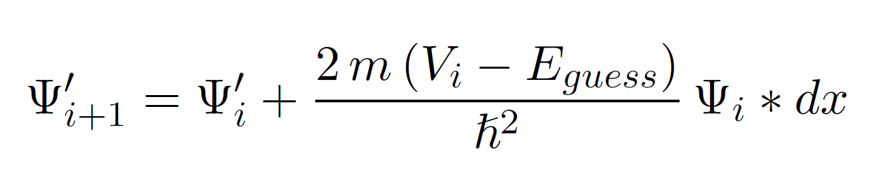
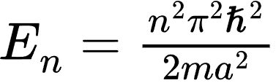
Using Euler’s Method for Wave Estimations in the 1-D Particle in the Box Problem Derek Violette
–
The Ohio State University / College of Engineering / Department of Computer Science and Engineering
The Ohio State University / College of Engineering / Department of Computer Science and Engineering
Development of an Artificial Backpropagation Neural Network for Classification of Irises Ruksana Kabealo, Dr. Golrokh Mirzaei
INTRODUCTION
The particle in the box problem in quantum mechanics asks the question: “if you put a particle in a square well where in that well can the particle be found?”. Unlike in classical physics knowing exactly where the particle can be found is impossible. But we can know the probability of finding the particle at any given point. Normally this can be solved by finding the solution to the time independent Schrödinger equation. While this works, to do this requires an understanding of 2nd order differential equations to solve. Instead, we can use a known equation and Euler’s method to create wave estimations for any Eigenenergy value.
The 2nd equation can be derived from rearranging the time independent Schrodinger equation for the 2nd derivative and substituting it into the first derivative of the first equation.
Problems
While Euler’s Method works great it is not without its flaws. There are two primary issues with this method. First, runtime, the way this would be implemented in code is with a loop, due to the sequential nature of the process. This means the runtime increases linearly as delta x gets smaller. It also means the loop must run each time a linear approximation is called, making repeat calls slow. Secondly, some amount of error will be accrued per step, because it is a linear projection based on tangent lines. This error can show up in interesting ways.
Moving Beyond Infinite Potential
Euler’s Method still holds true. But there are a new set of considerations that need to accounted for. When dealing with the other well types: finite potential, asymmetric well, and circular well – the initial value problem ends up getting more complex. This is due to the concept of quantum tunneling. Even though there is some well containing the particle, it is no longer an impenetrable wall and has a chance to exit the well. This now means the starting point for the initial value problem needs to be calculated. This also affects the derivative at the bound. We now have another equation that meets the wave at the wall. This equation to be continuous with the wave so the derivative at 0 can be found as the derivative of the outer function at 0.
Time Independent Schrodinger Equation
Finding Eigenenergy Values
In the second equation there is an E guess value. This value is not arbitrary. Even though the problem can be broken down into an initial value problem. The wave also has an end bound condition in the case of an infinite square well the wave function at the end of the box must also equal zero. This limits the number of valid solutions
A representation of an infinite square well
A plot where dx was too small to be a good approximation
Euler’s Method
This method involves breaking down a curve into a set of linear projections that are tangent to the curve with slopes determined by the first derivative . Another trait of this method is that it starts from a set of initial conditions. This is a great method for the particle in a box problem allowing it to be rewritten as a pair of equations instead of a 2nd order differential equation. The initial conditions for this set up can be reasoned from the boundary conditions of the well. Starting from 0 in contrast, the derivative of the wave at zero is a guess value and is arbitrary. The equations that describe the behavior of the wave using this method can be described as:
Conclusion
Euler’s method can be a very effective tool for approximating wave forms when dealing with the 1-D particle in the box problem. It does this by allowing Schrodinger’s equation to broken down into a pair of equations that make it into an initial value problem. Schrodinger’s equation being broken down also makes it easier for it to be processed by a computer and easier to work with in code. While Euler’s method is an effective tool it is best suited for applications where repeated calls can be avoided and where precise results are not absolutely required.
A list potential solution shapes of a finite well where V > E
ACKNOWLEDGEMENTS AND REFERENCES
A list potential solution shapes of an infinite well
The author would like to thank the Ohio State University and the Department of Computer Science and Engineering.
Professor Terry with Illinois Institute of Technology
Dr. Golrokh Mirzaei with the Ohio State University
Spencer Eckler, MCogSc
While there are an infinite number of valid solutions these are at particular energy values. These are referred to as eigenenergy values. For an infinite square well these values can be described by the equation.
Where m is the mass of the particle, V is the potential of the well, E is the energy of the particle and ℏ is the reduced Plank’s constant.
Where a is the with of the well
WEBSITE / URL

